Slide 1
Standing Waves on a Vibrating String
By Jacob Stanley and Edmond Klarić

Slide 2
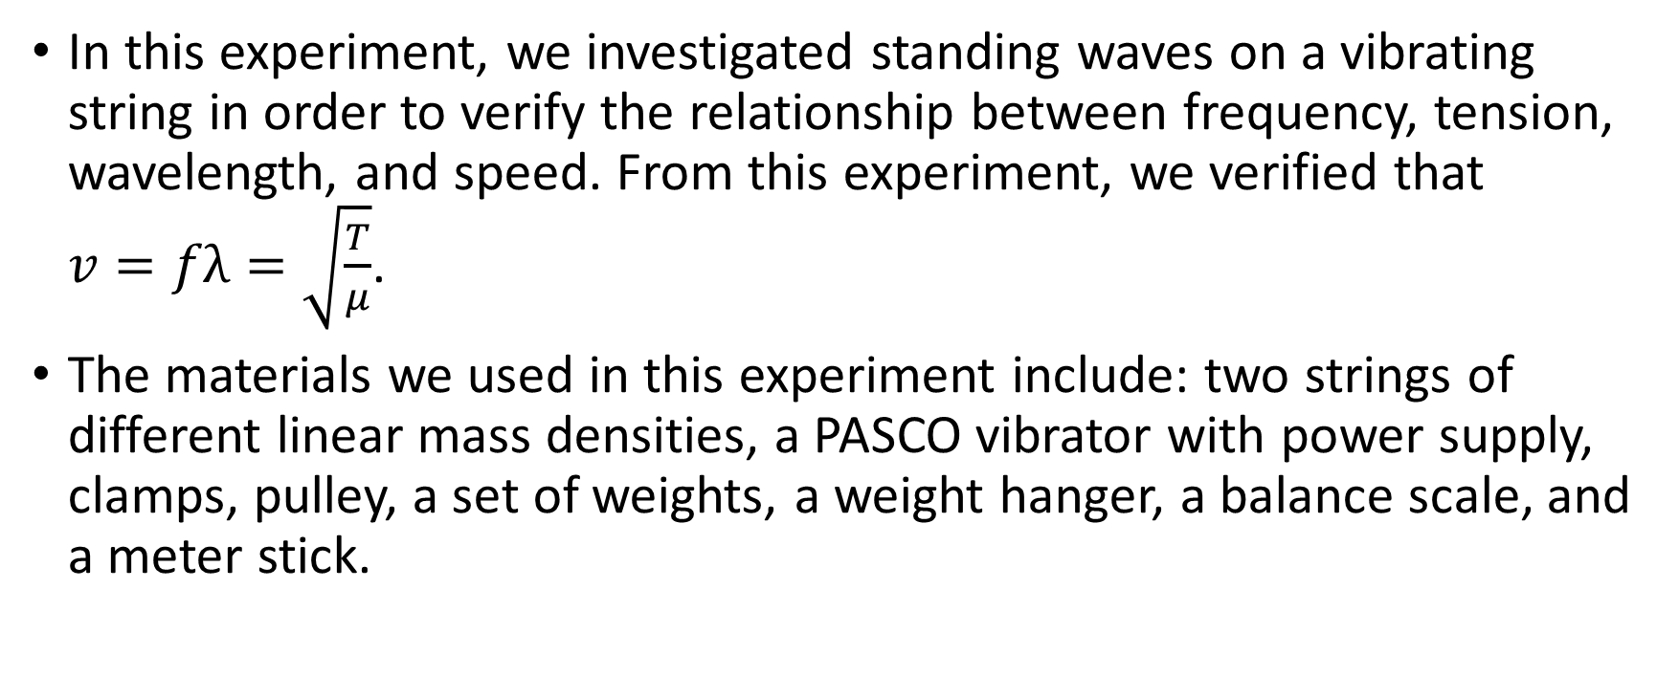
Introduction
In this experiment, we investigated standing waves on a vibrating string in order to verify the relationship between frequency, tension, wavelength, and speed. From this experiment, we verified that $v=fλ=\sqrt{\frac{T}{μ}}$.
The materials we used in this experiment include: two strings of different linear mass densities, a PASCO vibrator with power supply, clamps, pulley, a set of weights, a weight hanger, a balance scale, and a meter stick.

Slide 3
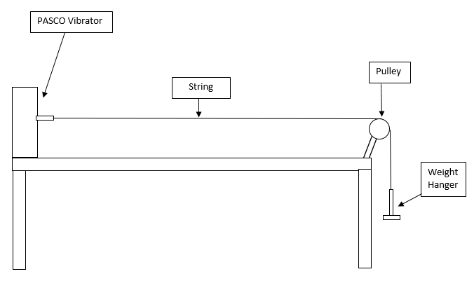
Professional Artist’s Rendition of Our Setup

Slide 4
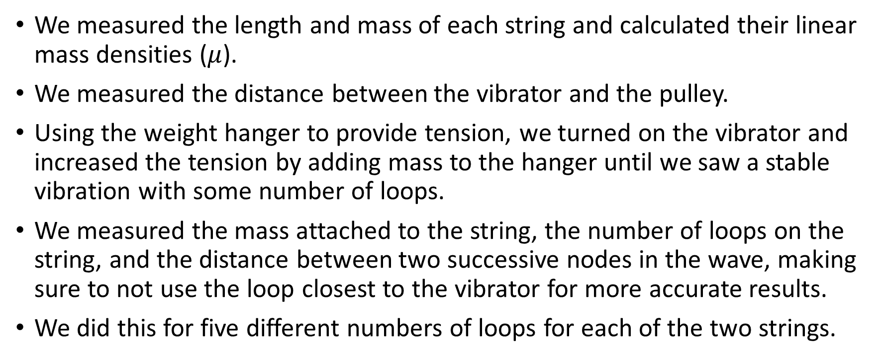
Procedure
We measured the length and mass of each string and calculated their linear mass densities ($μ$).
We measured the distance between the vibrator and the pulley.
Using the weight hanger to provide tension, we turned on the vibrator and increased the tension by adding mass to the hanger until we saw a stable vibration with some number of loops.
We measured the mass attached to the string, the number of loops on the string, and the distance between two successive nodes in the wave, making sure to not use the loop closest to the vibrator for more accurate results.
We did this for five different numbers of loops for each of the two strings.

Slide 5
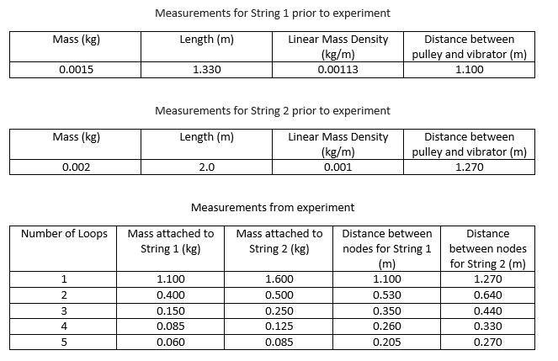
Measurements and Calculations

Slide 6
Measurements and Calculations Continued
Wavelength = (Distance between nodes) x 2
Tension = (mass attached to string) x g, where g = 9.81 m/s²
We plotted the tension vs. wavelength² in two graphs, one graph for each string.
Number of Loops | Wavelength for String 1 (m) | Wavelength for String 2 (m) | Tension in String 1 (N) | Tension in String 2 (N)
1 | 2.200 | 2.540 | 10.79 | 15.70
2 | 1.060 | 1.280 | 3.924 | 4.905
3 | 0.700 | 0.880 | 1.472 | 2.453
4 | 0.520 | 0.660 | 0.834 | 1.226
5 | 0.410 | 0.540 | 0.589 | 0.834

Slide 7
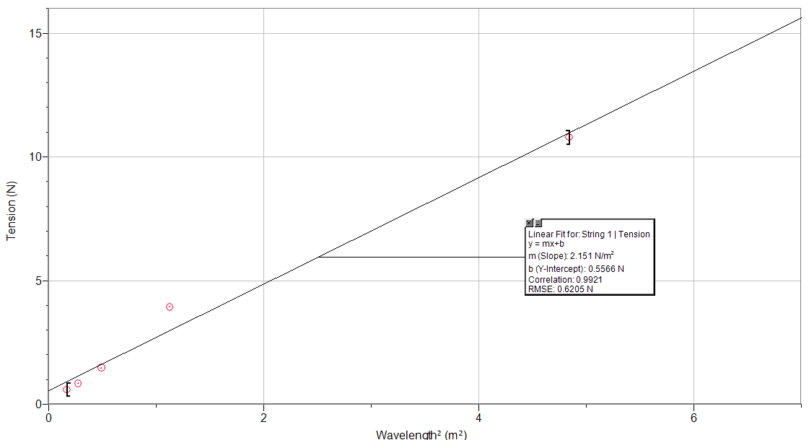
Graph of Tension (N) vs. Wavelength² (m²) (String 1)

Slide 8
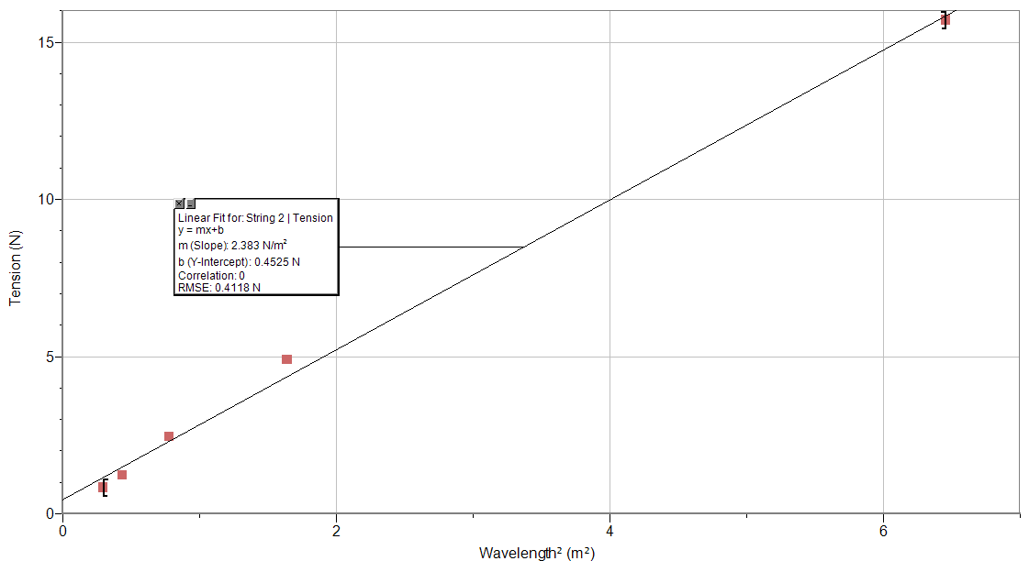
Graph of Tension (N) vs. Wavelength² (m²) (String 2)

Slide 9
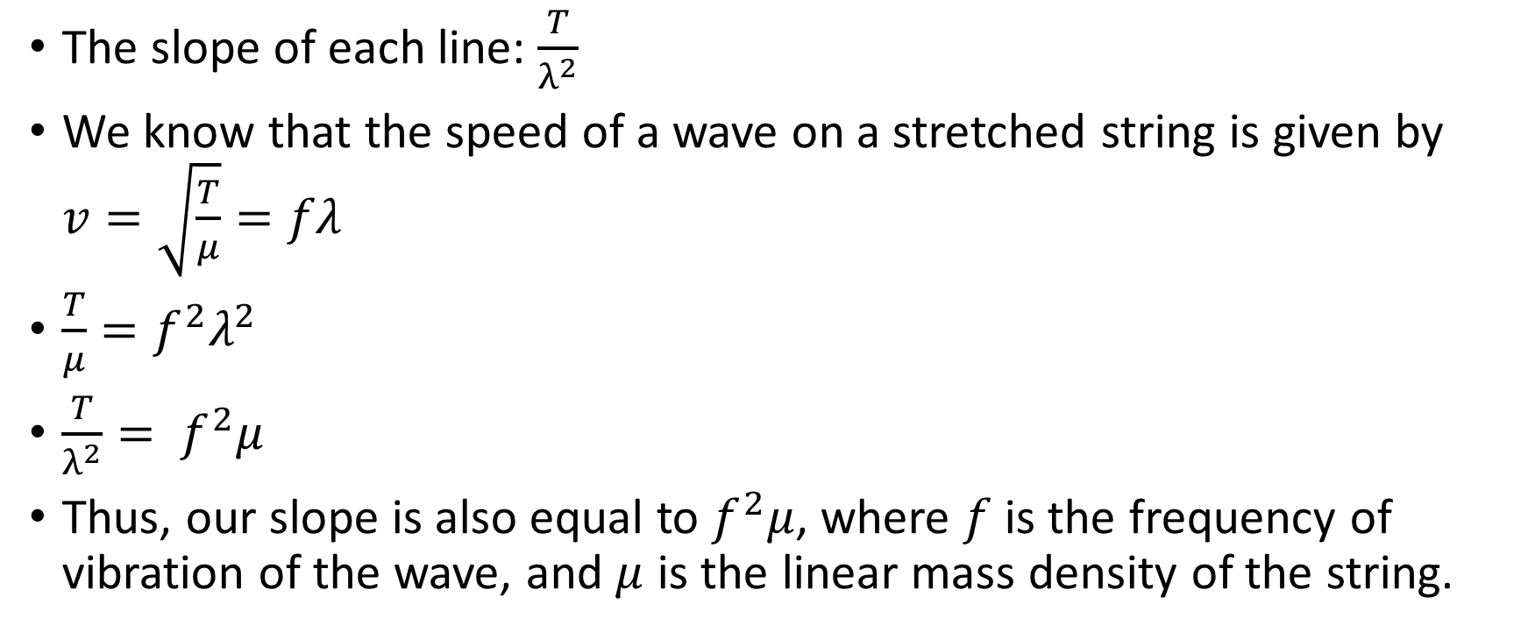
Results/Analysis/Physics
The slope of each line: $\frac{T}{λ^{2}}$
We know that the speed of a wave on a stretched string is given by $v=\sqrt{\frac{T}{μ}}=fλ$
$\frac{T}{μ}=f^{2}λ^{2}$
$\frac{T}{λ^{2}}= f^{2}μ$
Thus, our slope is also equal to $f^{2}μ$, where $f$ is the frequency of vibration of the wave, and $μ$ is the linear mass density of the string.

Slide 10
Results/Analysis/Physics Continued
This allows us to find the frequency of the wave on each string:
Frequency for String 1: 43.630 Hz
Frequency for String 2: 48.820 Hz

Slide 11
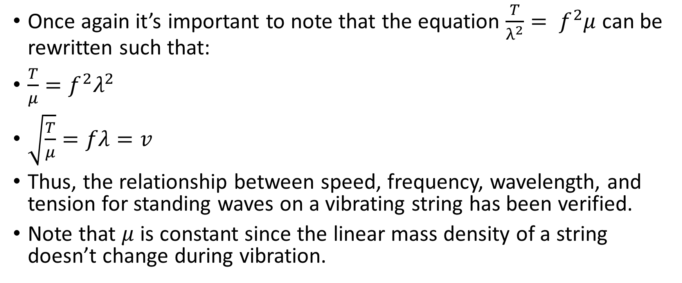
Conclusion
Once again it’s important to note that the equation $\frac{T}{λ^{2}}= f^{2}μ$ can be rewritten such that:
$\frac{T}{μ}=f^{2}λ^{2}$
$\sqrt{\frac{T}{μ}}=fλ=v$
Thus, the relationship between speed, frequency, wavelength, and tension for standing waves on a vibrating string has been verified.
Note that $μ$ is constant since the linear mass density of a string doesn’t change during vibration.

